Slide 1
Coding as classical scholarship
Katy Felkner
Advisor: Dr. Samuel Huskey, Classics and Letters
OU WiE First Year Interest Group
November 29th, 2017

Slide 2
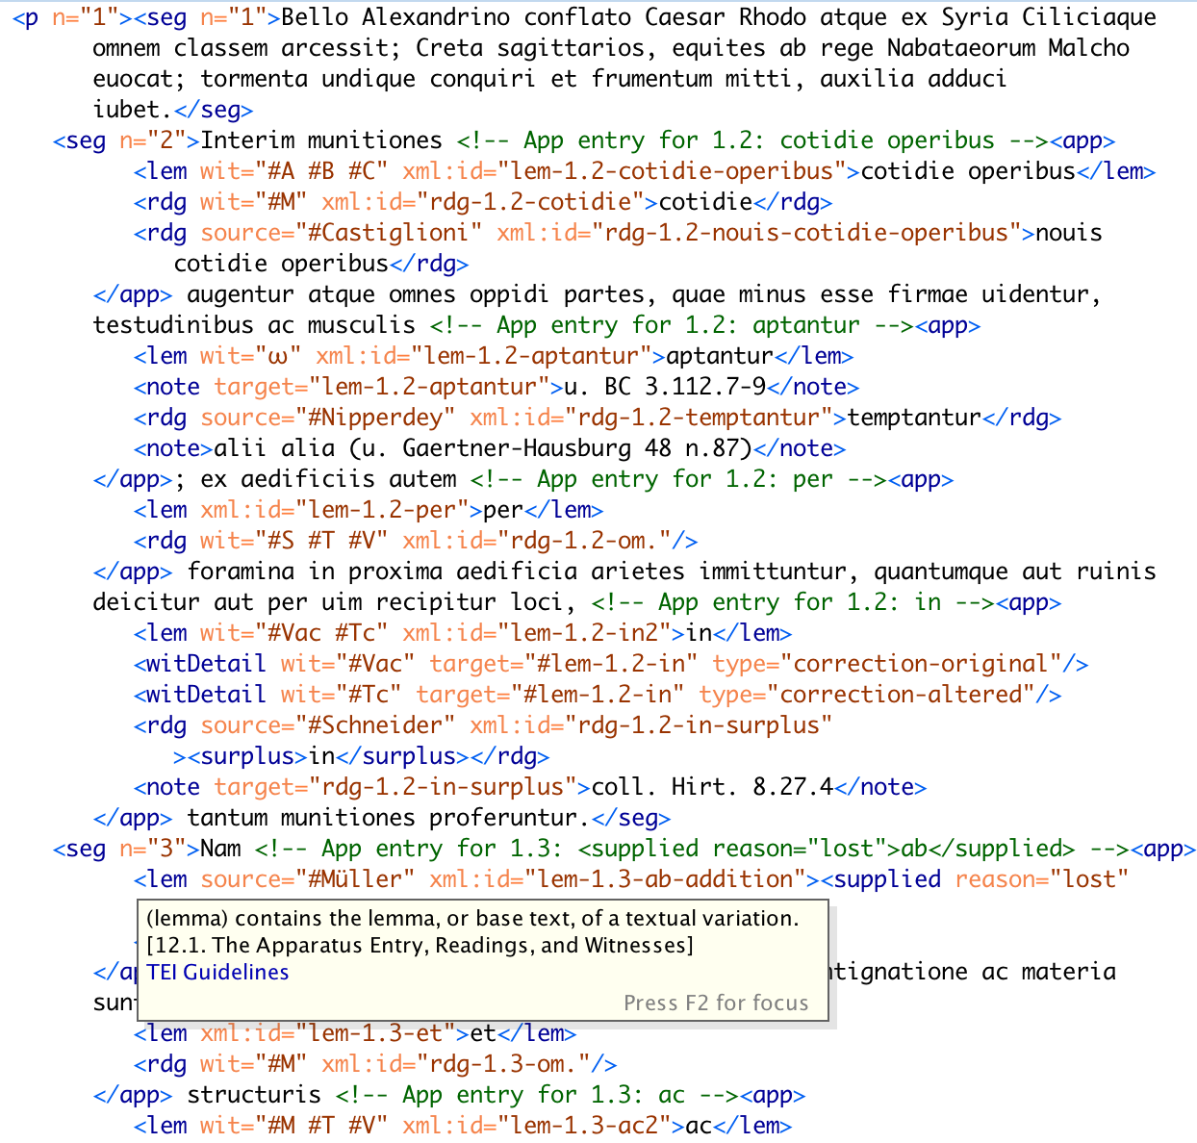
Notes:
A traditional critical edition, which includes an edited version of an ancient text and possible alternate readings, is visually encoded data which is understandable by a person with relevant background. It is not machine readable.
An XML-encoded edition is a machine readable representation of the same textual data. It allows us to use computers to visualize, analyze, and better understand the text.
The goal of my project was to develop a software tool which automates this encoding in order to facilitate the creation of new digital critical editions.

Slide 3
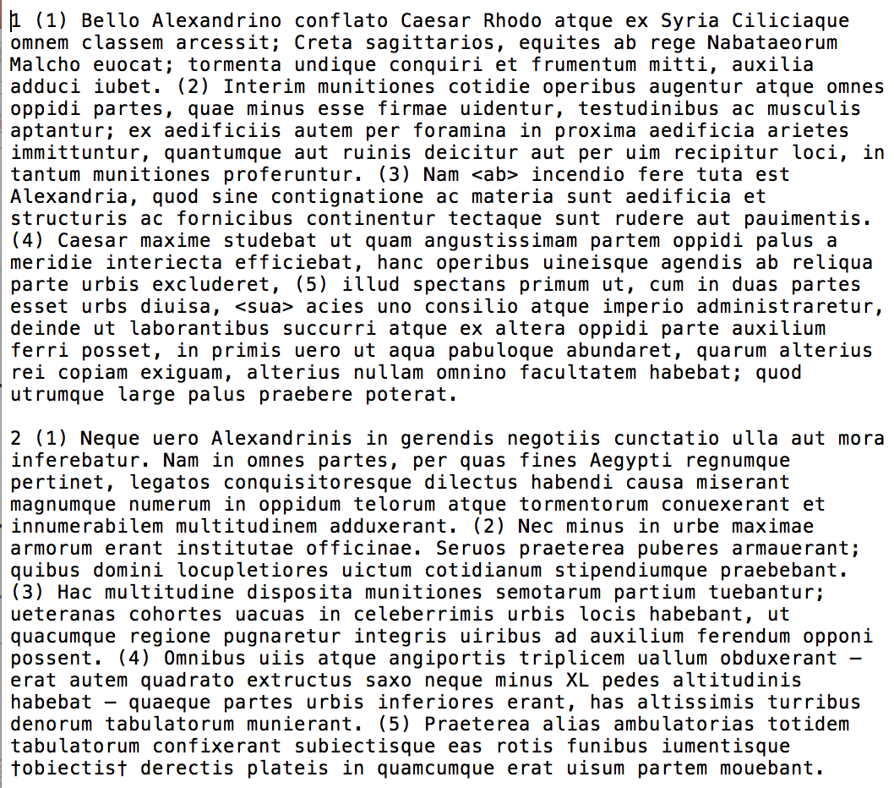
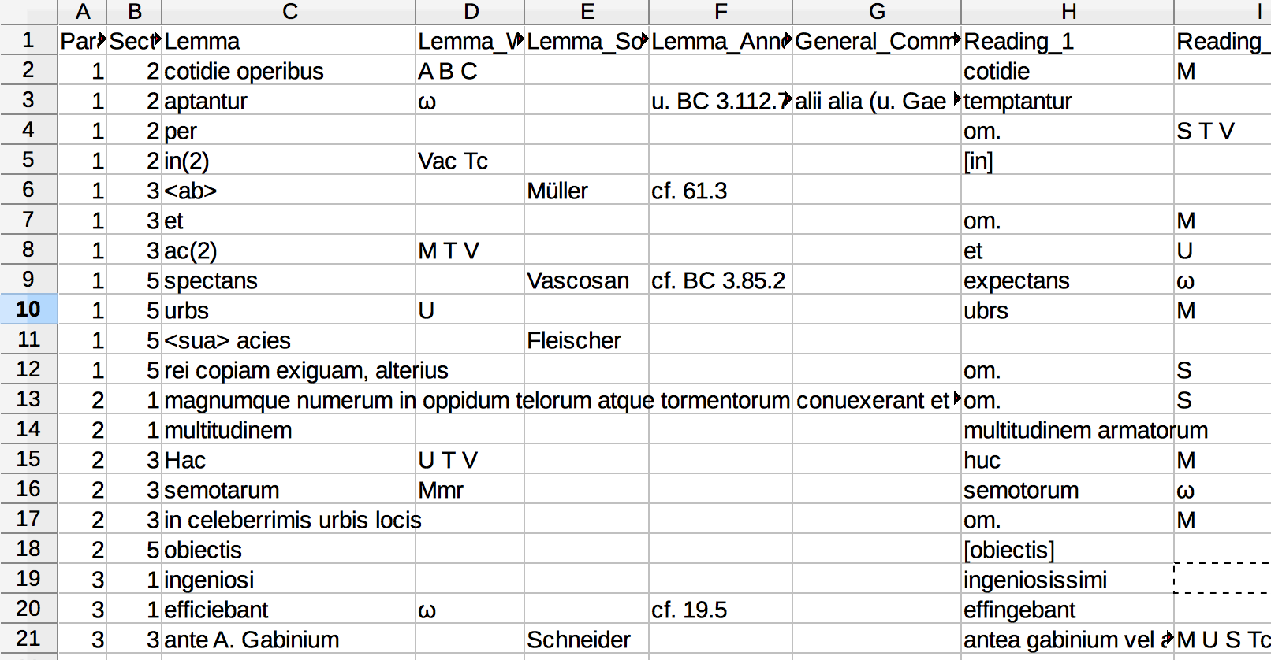
Notes:
In particular, I have developed a python script which automates the creation of a fully-encoded critical edition from a plain text file and a text CSV app crit.
On the left is a plain text version of Caesar’s Bellum Alexandrinum. It includes only the text itself, paragraph and section numbers, and very limited markup. Unlike the printed critical edition in the last slide, it does not include information about alternate readings or other critical data.
On the right is the critical apparatus. The actual input is a plain CSV (comma separated values) file but it is shown here as a spreadsheet for clarity.

Slide 4
Demo time!
Notes:
I’ll switch over to python and show my demo here!

Slide 5
Applications and Takeaways
Most classics faculty do not have coding background or the time to learn XML
My script allows them to produce XML encoded critical editions without having to code!
Data entry into the spreadsheet is not difficult and does not require coding knowledge.
Future research goals:
Performance improvements (running faster on longer texts)
Processing poetry as well as prose

